Slide 1

ENERGY MONITOR FOR APPLIANCES
By Oussema Ben Ayech

Slide 2

CONTENT
Introduction
Problem Statement
Objectives
Hardware & Software
How it works
Conclusions
1
2
3
4
5
6

Slide 3
INTRODUCTION
This IoT project monitors appliance energy usage using a current sensor and micro-controller. By analyzing real-time power consumption, displaying data locally, and sharing it to the end user, it reduces costs and raises energy awareness, proving IoT’s role in efficient resource management.

Slide 4
PROBLEM STATEMENT
In residential, commercial, and industrial settings, manual energy audits and periodic meter checks fail to detect phantom loads (e.g., standby devices) and inefficient appliances (e.g., aging refrigerators). This leads to:
Financial waste: Undetected high-energy devices inflate bills.
Environmental harm: Excess consumption strains grids and increases CO₂ emissions.
Safety risks: Overloaded circuits due to unmonitored appliances.

Slide 5

EXISTING METHOD
Current systems rely on manual clamp meters or static smart plugs, offering fragmented data and no real-time appliance-level insights. Traditional tools ignore dynamic usage patterns, leaving costly inefficiencies undetected.

Slide 6

PROPOSED METHOD
This system useas a non-invasive SCT-013 current sensor and Arduino Mega to track real-time appliance energy consumption. It triggers immediate visual alerts (e.g., LEDs, buzzer) when usage exceeds a specific current, such as standby power waste or dangerous overloads. The Arduino processes data locally, eliminating manual checks by providing instant, actionable feedback

Slide 7
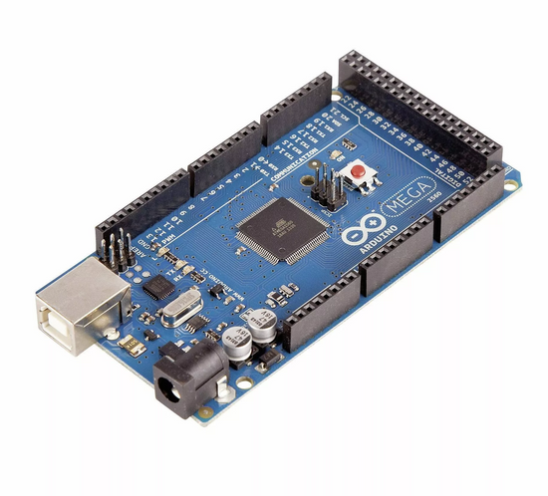
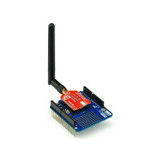
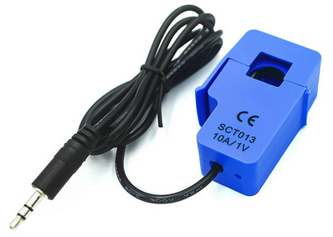
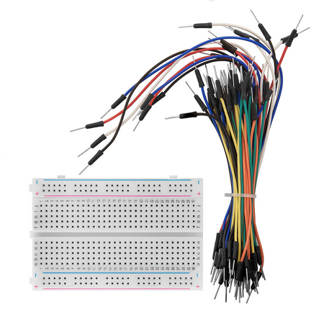
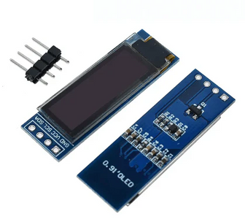
COMPONENTS
Arduino uno rev3
Wi-Fi Shield ESP8266
SCT-013 Current Sensor
SSD1306 Display OLED 0.91" LCD 128X32
Breadboard + Wires

Slide 8
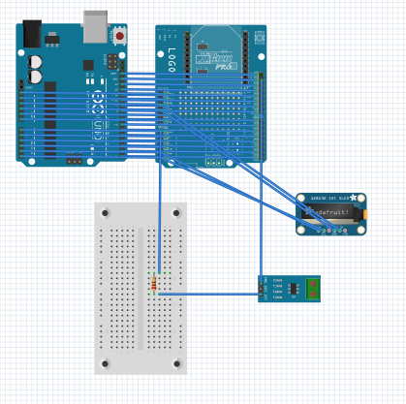
CIRCUIT DIAGRAM

Slide 9
SIMULATION

Slide 10
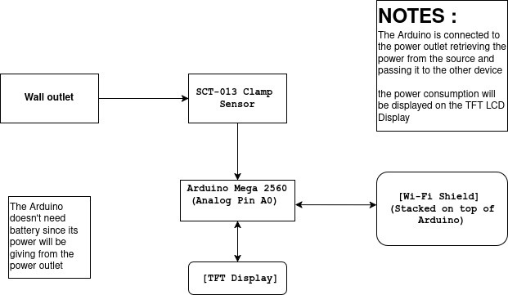
WORKING

Slide 11
CONCLUSION
This IoT project automates energy monitoring using non-invasive sensors and a microcontroller, eliminating manual tracking and optimizing usage in homes/offices. It showcases IoT’s power to transform everyday systems into efficient, sustainable solutions through real-time data and smart alerts.

Slide 12
THANK YOU

